Slide 1
NCI AIIMS - JHAJJAR
STATUS AS ON 27.10.2016

Slide 2
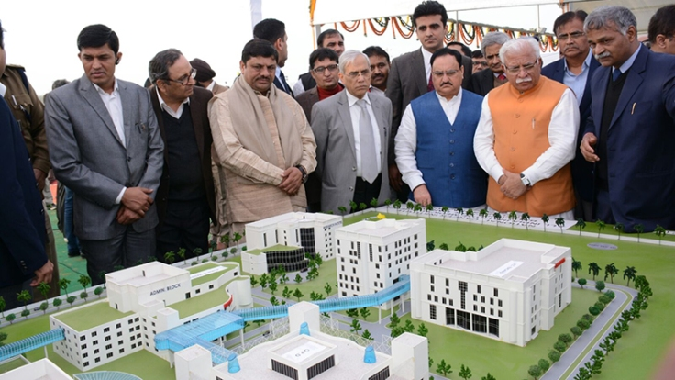
Scaled Model of NCI observed by Hon’ble Health Minister with other dignitaries

Slide 3
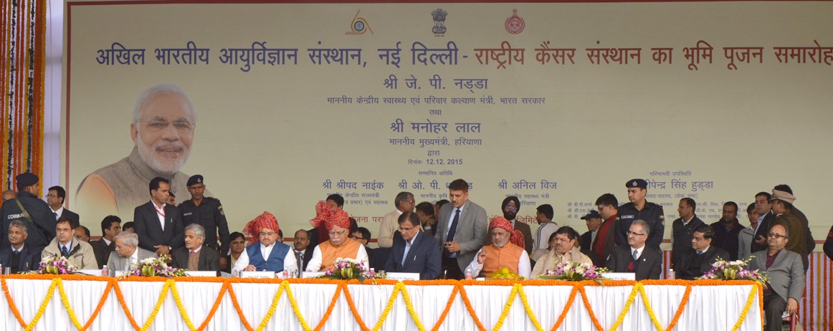
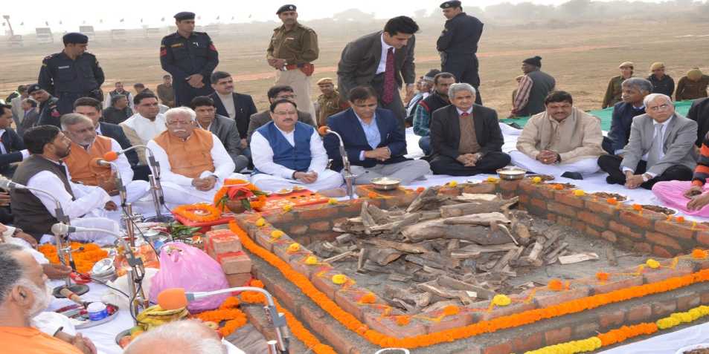
BHOOMI PUJAN BADSA, JHAJJAR
Bhoomi Pujan: 12th December, 2015

Slide 4
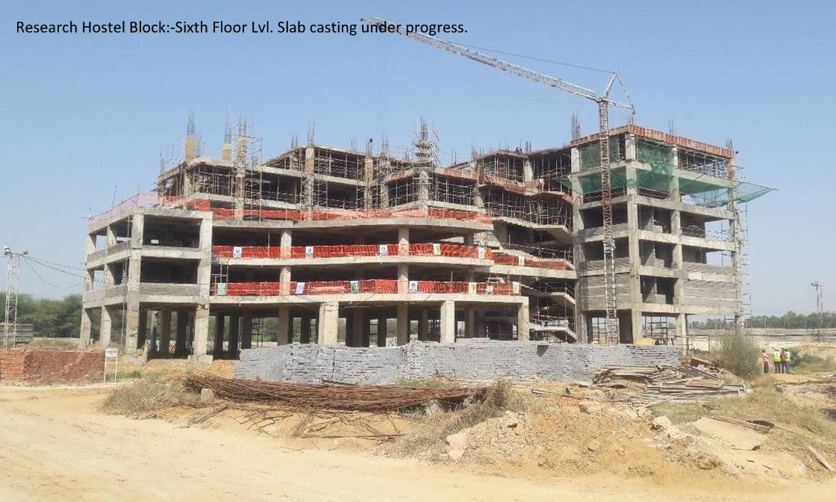
RESEARCH HOSTEL BLOCK

Slide 5
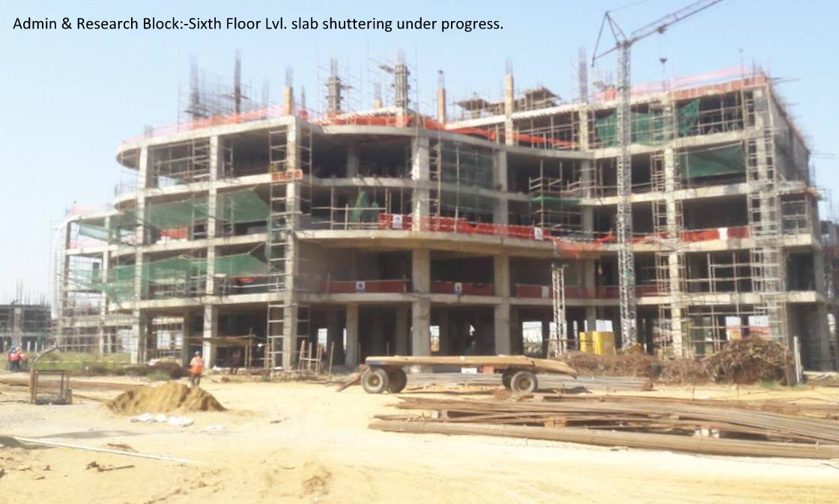
ADMIN & RESEARCH BLOCK
23.09.16

Slide 6
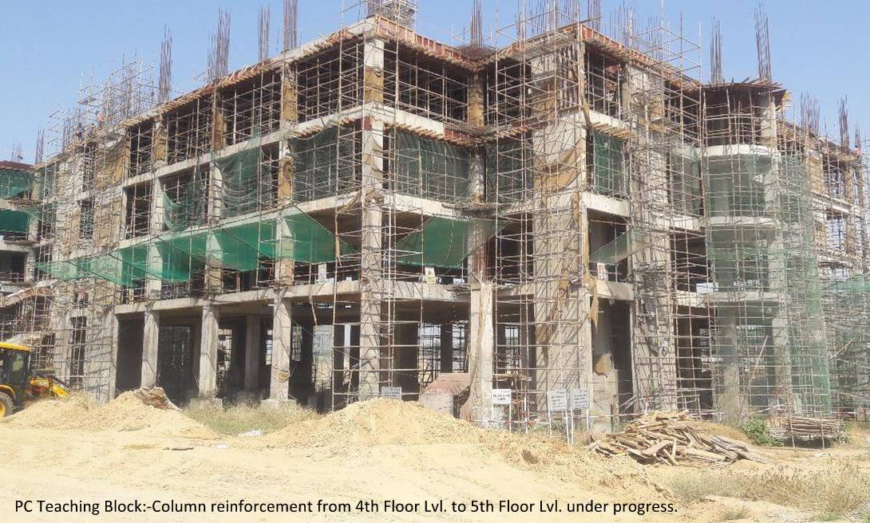
PC TEACHING BLOCK
23.09.16

Slide 7
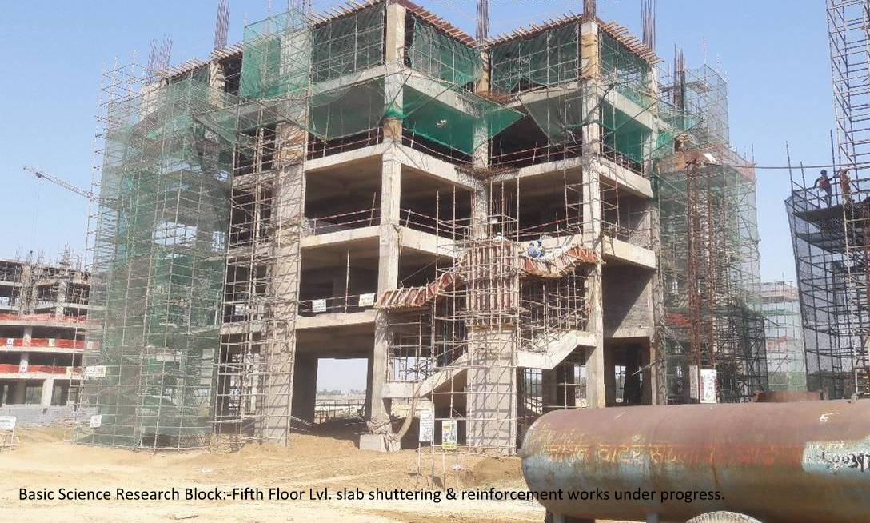
BASIC SCIENCE RESEARCH BLOCK
23.09.16

Slide 8
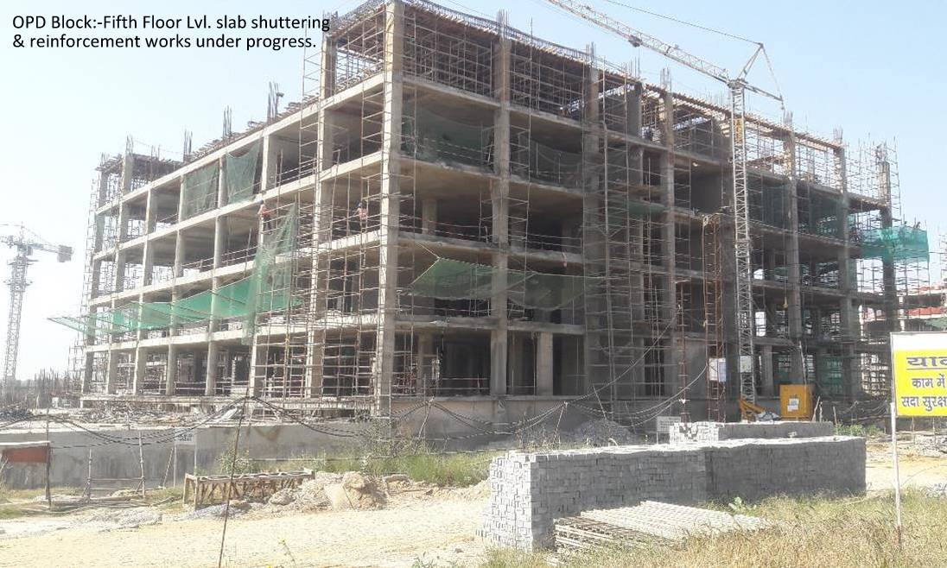
OPD BLOCK

Slide 9
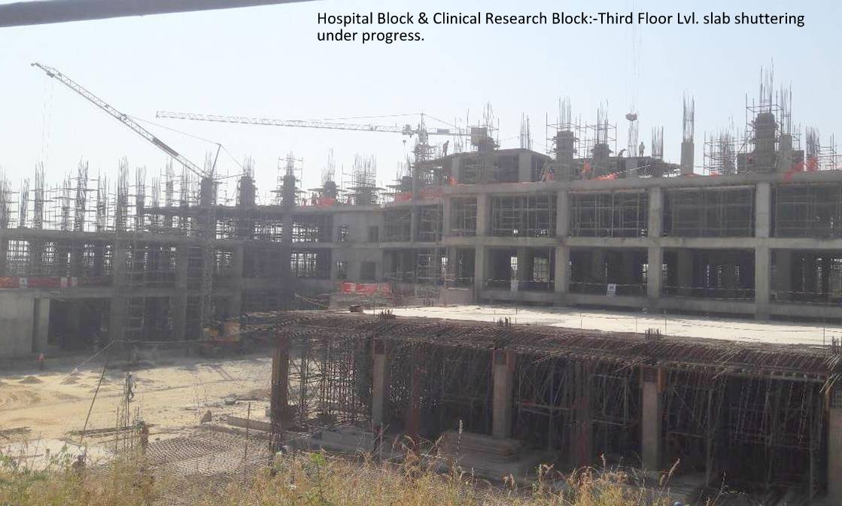
HOSPITAL & CLINICAL RESEARCH BLOCK

Slide 10
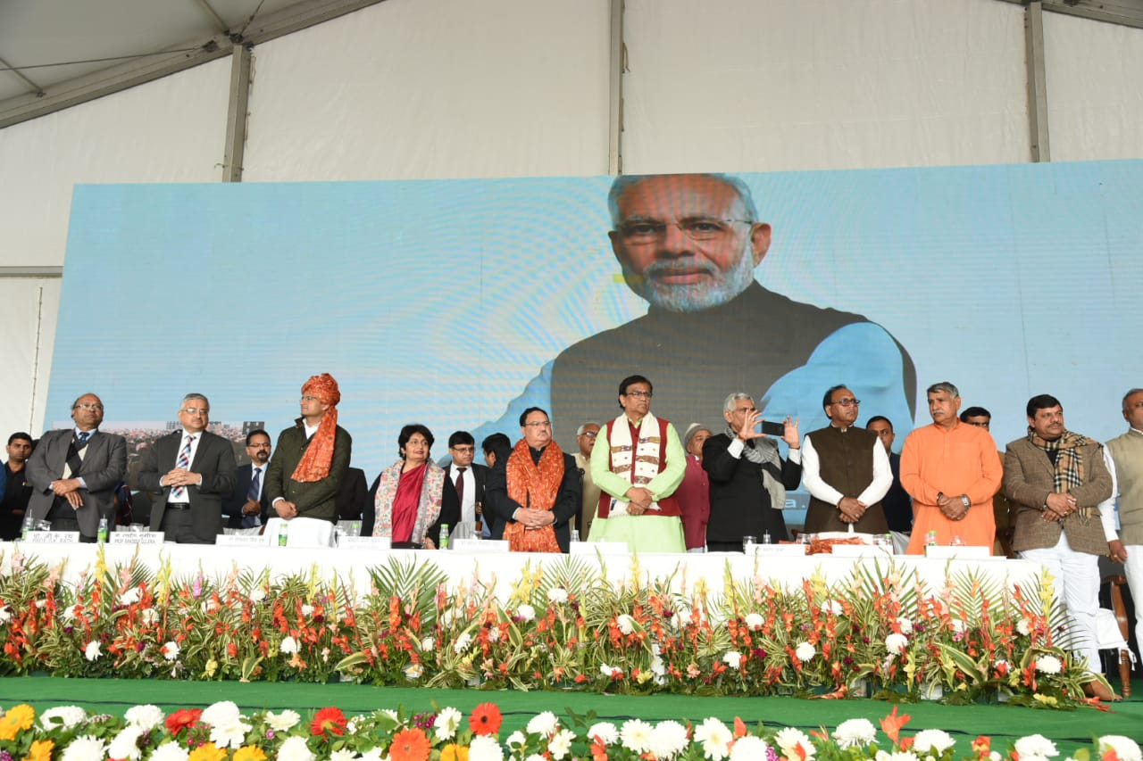
Dedicated to the Nation by Hon’ble Prime Minister: 12th Feb 2019

Slide 11
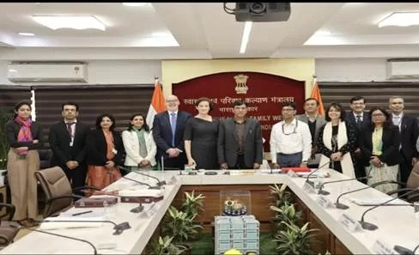
5th Foundation day, NCI Jhajjar

